Slide 1
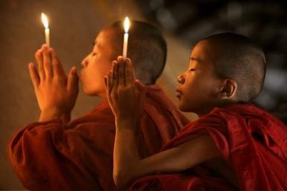
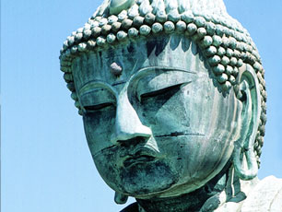
Buddhism
Aditya,Theda
http://www.religionfacts.com/buddhism/images/people/bagan-monks-c-awfulsara-565.jpg
http://www.bbc.co.uk/religion/religions/buddhism/images/mainpromo.jpg
http://upload.wikimedia.org/wikipedia/commons/thumb/d/df/Dharma_Wheel.svg/220px-Dharma_Wheel.svg.png

Slide 2
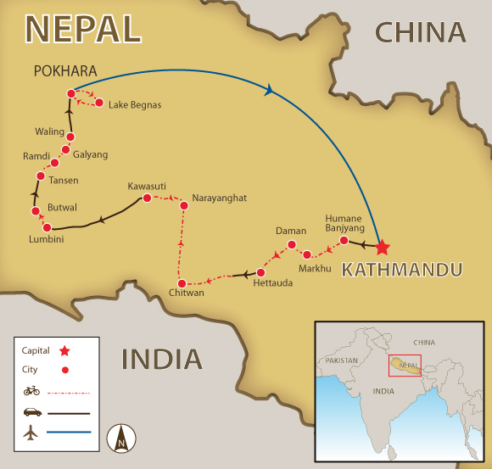
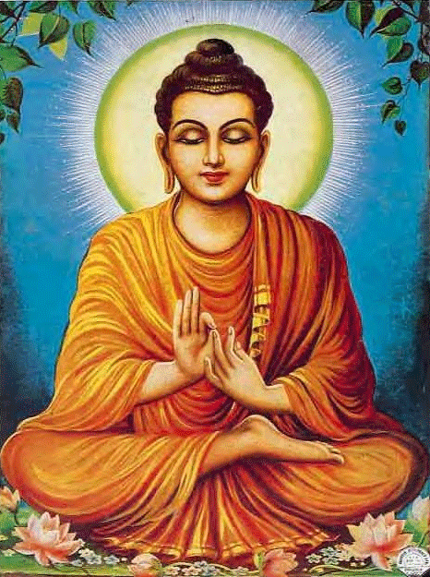
Beginning
2,500 YEARS AGO

Slide 3
Siddhartha Gautama
Born from a royal family in Lumbini (now it became Nepal) at 563 BC.
Raised by his mother’s beloved sister, Mahaprajapati because his mother, Mahamaya died 7 days after he was born.
At age 29 he saw the outside world. He realized that living as a prince, and the luxuries will no longer provide him happiness.
So he went away and studied religion for 6 years. When he finished his study, he meditated and he was enlightened

Slide 4
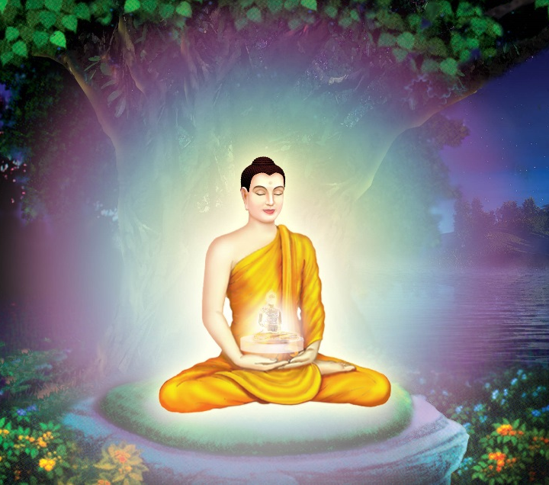
Enlightenment
- According to tradition, one evening Siddhartha sat down in the shade of a banyan tree near a temple of the Hindu god Vishnu ,at a place called Bodh Gaya in India.
- He stayed there all night, deep in meditation. Then, as dawn broke, he saw the meaning of all things: he was enlightened.
- From this point on, Siddhartha was known as the Buddha.

Slide 5
Three universal truth
Everything in life is impermanent and always changing.
Impermanence leads to suffering. Nothing remains the same makes life unsatisfactory.
There is no unchanging personal self.

Slide 6
Four Noble Truth
Dukkha: Human has a lot of suffering
Samudaya: There is cause of suffering
Nirodha: There is an end of suffering
Magga: The only way to end the suffering is to follow the eightfold path

Slide 7
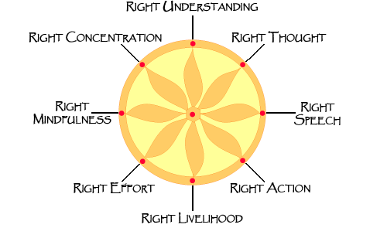
THE EIGHTFOLD PATH

Slide 8
5 Precepts

Slide 9
Some Buddhism Stories
Monkey King / Journey To The West
The Blind Men and The Elephant

Slide 10
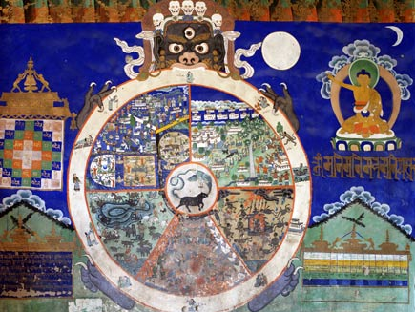
Wheel of Life
Realm of humans
Realm of gods (Titans)
Realm of hungry ghosts
Realm of animals
Realm of hell
http://www.bbc.co.uk/religion/galleries/bhavachakra/images/01.jpg

Slide 11
Fundamental Questions
Who am I?
There is no “I”
Everything comes and goes
Everything is connected
Why am I here?
To receive sufferings, consequences from the previous lives.
To be born to learn the nature of reality and to be enlightened so no more rebirth.
Constant rebirth because not knowing the true nature of reality, no person/animal/self, only body and mind.
To live life to its fullest, indulge in every good thing the world has to offer
What is my purpose in life?
To be awakened, to seek enlightenment and to end suffering.
What defines right and wrong?
Buddha’s teachings (Ex.Five Precepts, Eightfold Paths)

Slide 12
Fundamental Questions
What prompts my moral behavior?
Too seek enlightenment
Follow Buddha’s teachings
Karma - Rebirth
What is death? What happens after I die?
Death isnt the end of life, end of body
Spirit remain, seek out new life
Rebirth into one of 6 realms based on karma
Does God exist? Who is God?
Gods are the central focus of most religions
Buddha taught that beliving in gods wasn’t useful to realize enlightenment

Slide 13
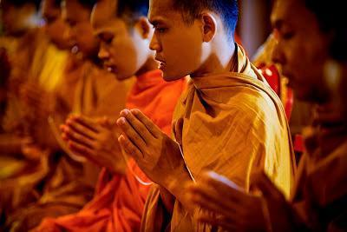
Practising Buddhism
Practise the three jewels
Respect to Buddha’s teachings
Chanting
Meditating
http://4.bp.blogspot.com/-cKiuqsdpAaM/UPgQN3ZVOoI/AAAAAAAABXs/f7gy5gFvm40/s400/munkar.jpg

Slide 14
The Three Jewels
The Buddha
Dharma, Buddha’s teachings
Sangha, community of Buddhist monks or nuns
http://2.bp.blogspot.com/_TFjGQZYbyVI/TUstDAcNkmI/AAAAAAAAAw0/CZ2dsbcc6VU/s200/3-jewels-triratna+-+Marc.jpg

Slide 15
Respect To Buddha’s Teachings
Isn’t worshiped as a god, instead his teachings-enlightenment
Offerings brought to shrines/temples
Flowers: fresh today but will die eventually like our human bodies
Light (candles/butter lamps): gives light as the Buddha’s teachings gives truth and light.
Incense: Symbol of the sweet fragrance of the Buddha’s teachings.

Slide 16
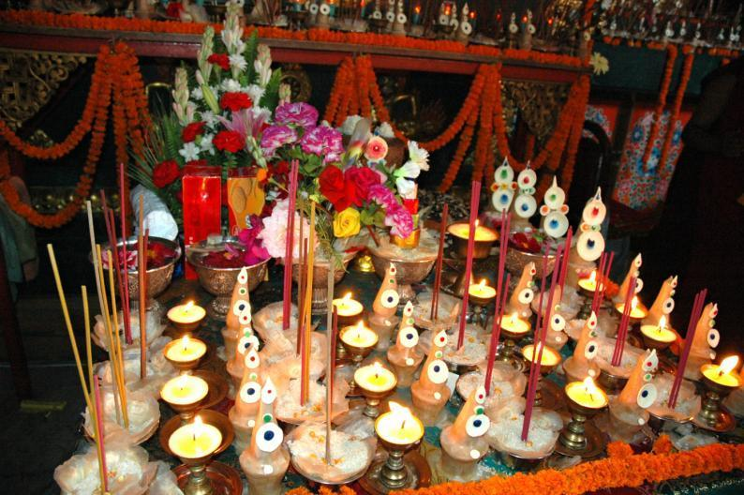
http://farm5.staticflickr.com/4009/4687243758_dd9aabf3f3_o.jpg

Slide 17
Chanting
Gongs or drums played
Priests prepare offerings brought to altar
Chants come in different languanges, foreign, even English
Types of chants
Mantra: Short words/syllables. Transformative power. Om mani padme hum, 3 Jewels.
Dharani: Longer than mantra. Teachings, repetitive, may result in special powers like protection/healing.
Purpose is for enlightenment, to awake from delusions

Slide 18
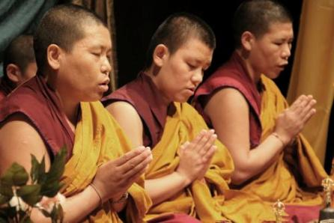
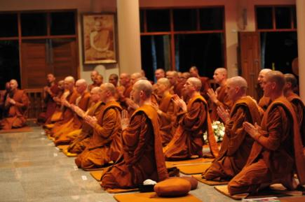
http://3.bp.blogspot.com/Ff6bvmsDYfE/UGCJJIHWwaI/AAAAAAAAEAk/vl4Jm1yXrTQ/s640/Mandala+2.jpg
http://www.buddhistteachings.org/wp-content/uploads/2013/02/Monks-Chanting-copy.jpg

Slide 19
Meditation
Essential to reach nirvana (enlightenment)
One searches themselves to truly understand Buddha’s teachings
Samntha, basis, peacefullness, empty mind from thoughts
Concentrating/breathing/focusing on a object, helps a person to have a calmer state.
Vipassana, mind is quite, focus on impermanence and change
Help Meditation
Crosshed legs/kneel on cushions
May offer flowers/incense to statue/image of Buddha
Image,statue,candle used for focus
Close eyes, count breathes

Slide 20
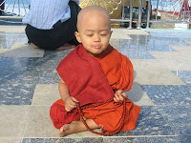
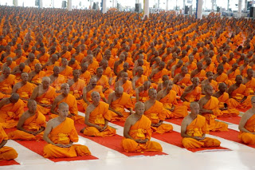
http://2.bp.blogspot.com/-iRkPig8fpC8/T1kJH8QPF1I/AAAAAAAAiFQ/jjLqHqY5pZo/s200/meditation%2Bbuddhist_meditation%2Balibaba%2Bcom.jpg
http://4.bp.blogspot.com/-iIOSGuqNdxs/USmY9K5IXnI/AAAAAAAAB2w/vP6DyjVFA1E/s320/mass-ordination-ceremony-100000-novice-monks-in-buddhist-lent-session.jpg

Slide 21
Sources
"Buddhist Wheel of Life." BBC News. BBC, 2013. Web. 04 Sept. 2013. <http://www.bbc.co.uk/religion/galleries/bhavachakra/>.
Meredith, Susan, and Clare Hickman. The Usborne Internet-Linked Encyclopedia Of World Religions. London: Usborne, 2001. Print.
O'Brien, Barbara. "Chanting." About.com Buddhism. About.com, 2013. Web. 03 Sept. 2013. < http://buddhism.about.com/od/becomingabuddhist/a/Chanting.htm>
O'Brien, Barbara. "The Life of the Buddha." About.com Buddhism. About.com, 2013. Web. 08 Sept. 2013. <http://buddhism.about.com/od/lifeofthebuddha/a/buddhalife.htm>.
O'Brien, Barbara. "The Practice of Buddhism." About.com Buddhism. About.com, 2013. Web. 03 Sept. 2013. <
O'Brien, Barbara. "What Is Buddhism? An Introduction to Buddhism." About.com Buddhism. About.com, 2013. Web. 04 Sept. 2013. <http://buddhism.about.com/od/basicbuddhistteachings/a/basicshub.htm>.h ttp://buddhism.about.com/od/becomingabuddhist/a/practice.htm>
Tan, Chade-Meng. "A Few Buddhist Stories." A Few Buddhist Stories. Chade-Meng Tan, 1 Sept. 2013. Web. 04 Sept. 2013. <http://www.whatdoyouthinkmyfriend.com/Stories/>.
Wright, Chris. Buddhism for Today. Oxford: Oxford UP, 1997. Print.
Yang, Thich Nguyen. "Buddhist View on Death and Rebirth." Buddhist View on Death and Rebirth. N.p., 1999. Web. 04 Sept. 2013. <http://www.urbandharma.org/udharma5/viewdeath.html>.

