Slide 1
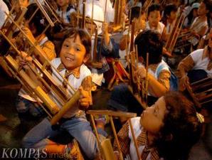
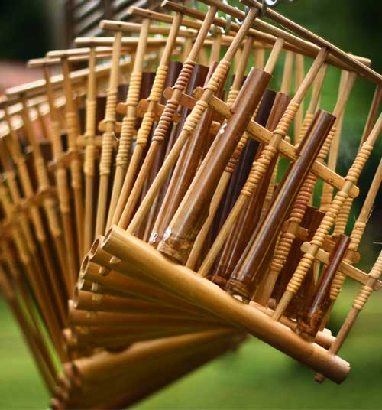
Angklung
By: Aditya and Matthew

Slide 2
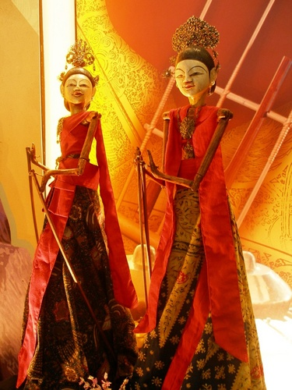
introduction - Sunda
The instrument “anklung” came from sunda. Sudanese people are an ethnic group which consist of 31 million people. Sundanese are mostly in Jawa barat, Jakarta and banten. Sundanese culture is similar with the java culture. Their prime religion would be islamic. During the 16th to 19th century, sunda used to be a great kingdom. But the dutch came and took over the place. The sundanese have artwork and cultures such as Wayang.

Slide 3
What is angklung?
Anklung is a musical instrument made from 2 bamboo tubes attached to a bamboo frame. Its origin is from Sunda. The tubes are then turned into octaves. During the time of the Sundanese Kingdom, angklungs are used as a signal for prayer time. Now days, angklung is a traditional music instrument which is used for background sound of dancing and other performances.

Slide 4
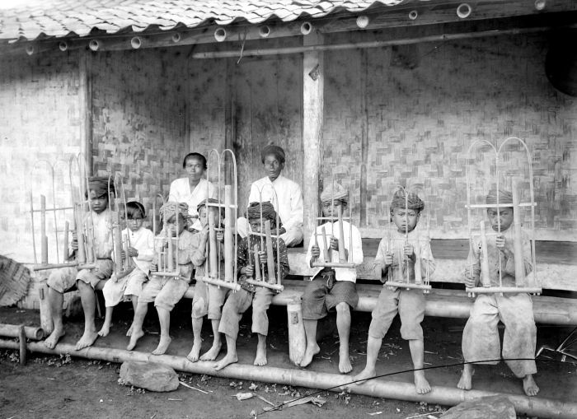
How is it played?
To play the angklung, you have to hold the base of the bamboo with one hand and another hand shaking the angklung. But one angklung only represents one note which means it is needed a number of angklungs to play a good melody. Angklungs are also part of an orchestra, the first one was at the Bandung conference at 1995.

Slide 5
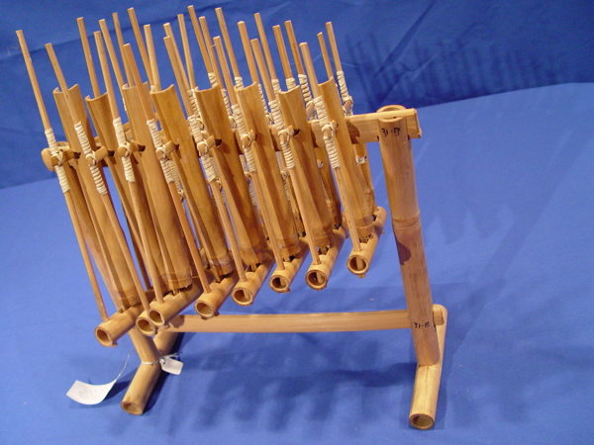
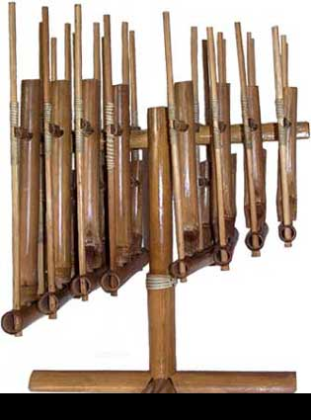
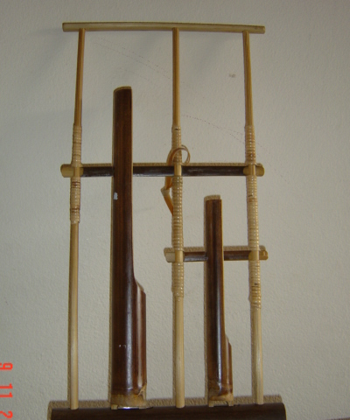
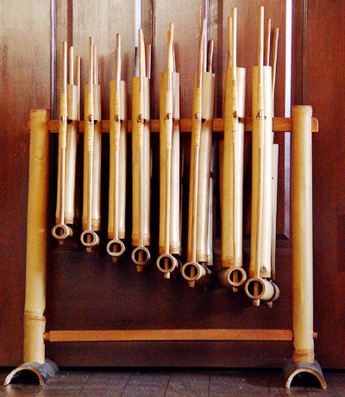
Pictures of angklung

Slide 6
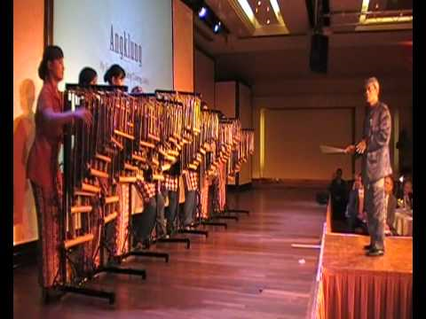
Some angklung songs
Gelang Si Paku Gelang
O Ina Ni Keke
Pulau Bali
Burung Kakak Tua
Pohon Beringin
Bunga Anggrek
Lapaloma
Bungong Jumpa
Ajo Mama
Duhil Sayo
Sarinande
Pileuleuyan
Besame Mucho

Slide 7
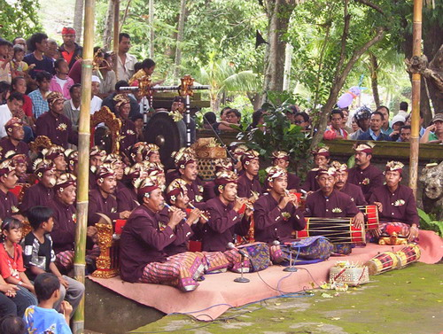
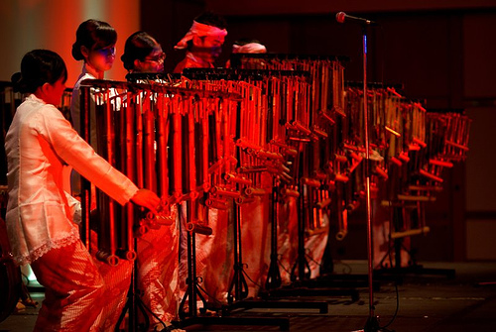
The angklung song”gelang si paku gerlang”

Slide 8
Umbrella – angklung version

Slide 9
Bibliography
http://www.musicmall-asia.com/malaysia/instruments/angklung.html
http://discover-indonesia.com/west-java/angklung-a-bamboo-music-instrument/
http://georgetterox.blog.friendster.com/files/anak-ank-sd-di-malaysia-dan-singapura-asyik-belajar-angklung.jpg
http://www.joshuaproject.net/people-profile.php?rog3=ID&peo3=15121
http://en.wikipedia.org/wiki/File:Wayang_Golek_Sundanese_Traditional_Puppet_Show.JPG

Slide 10
Thank you

