Slide 1
Edelweiss
Aditya wikara
9.2
05/11/2012

Slide 2
What is Edelweiss?
Edelweiss is a type of flower, comes from the German word. Edel means noble, weiss means white.
The song is from the 1959 Rodgers and Hammerstein musical The Sound of Music.
Composer: Richard Rodgers

Slide 3
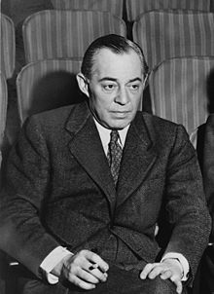
Richard Charles Rodgers
American Composer
Born – June 28, 1902 New York City
Death – December 30, 1979 New York City
More than 900 songs
43 Broadway musicals
Music for televisions

Slide 4
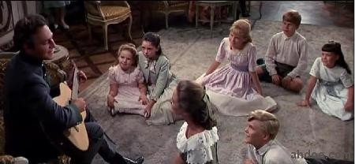
Meaning
Innocence
Peace
Love
Pride

Slide 5
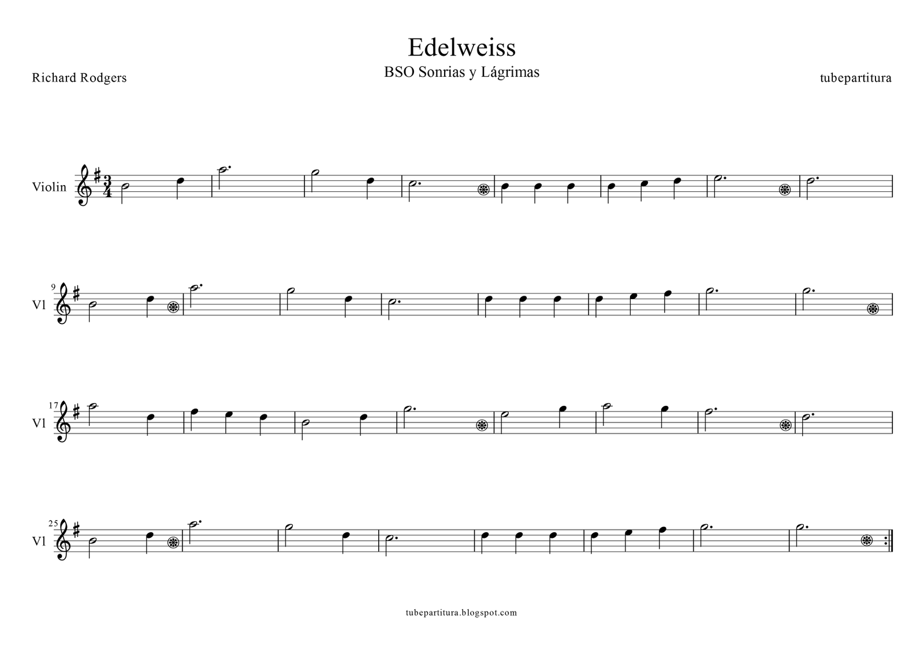
Music Sheet

Slide 6
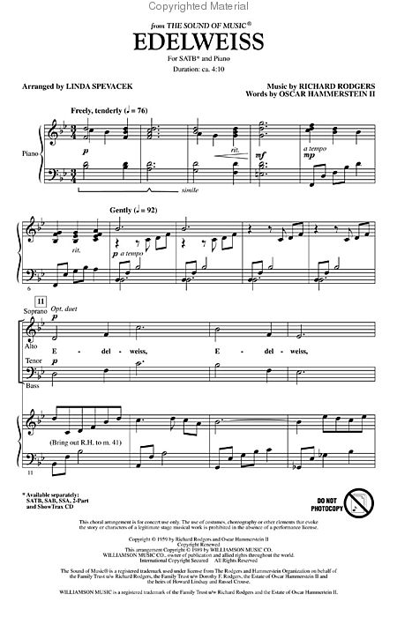
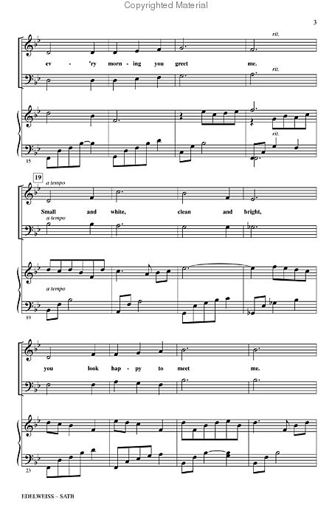

Slide 7
Analysis
Major Scale
Intermezzo – Freely, tenderly
Legato
Mezzo Forte
Mezzo Piano
Piano
Sharp

Slide 8
Thank You

Slide 9
Reference
Dickey, Timothy. "Edelweiss, Song (from "The Sound of Music") by Richard Rodgers on AllMusic." AllMusic. N.p., n.d. Web. 07 Nov. 2012. <http://www.allmusic.com/composition/edelweiss-song-from-the-sound-of-music-mc0002531089>.
Google. Google. Web. 7 Nov. 2012. <https://www.google.co.id/search?q=edelweis+composer&ie=utf-8&oe=utf-8&aq=t&rls=org.mozilla:en-US:official&client=firefox-a>.
http://upload.wikimedia.org/wikipedia/commons/thumb/b/bc/Rodgers.jpg/220px-Rodgers.jpg
http://4.bp.blogspot.com/_mPUhksQkf_o/Sp9omSyd3wI/AAAAAAAAAJg/A1M4PNHK6kQ/s400/EdelweissTheSoundOfMusic.jpg
http://amazing-seeds.com/images/edelweiss_01.jpg
http://www.siteadvisor.com/restricted.html?domain=http:%2F%2Fwww.ahdoe.com%2Fwp-content%2Fuploads%2F2008%2F04%2Fedelweiss.jpg&originalURL=-1057873881&pip=false&premium=false&client_uid=3890135655&client_ver=3.6.0.155&client_type=IEPlugin&suite=false&aff_id=0&locale=en_us&ui=1&os_ver=6.1.0.0
"The Sound of Music â Edelweiss." SongMeanings. Web. 07 Nov. 2012. <http://www.songmeanings.net/songs/view/108541/>.
"Sheetmusicplus.com." Look inside Edelweiss. Web. 07 Nov. 2012. <http://www.sheetmusicplus.com/look_inside/19222464>.

