Slide 1
Energy Transfer
Aditya, Caca, Sammy
Grade 8.1

Slide 2
Introduction
Energy transfer is how energy is moved from one place to another
A food chain is a description of how energy transfers in an ecosystem from organism to organism by eating each other

Slide 3
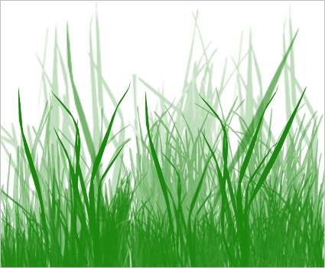
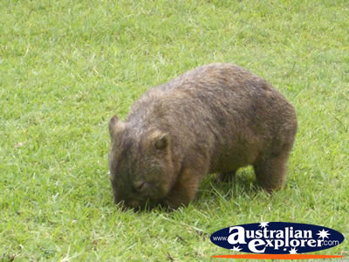
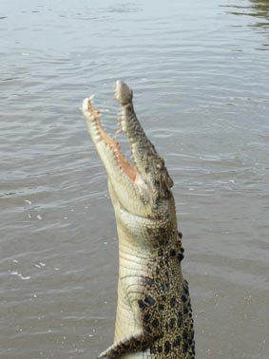
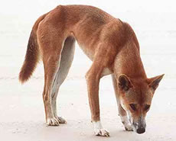
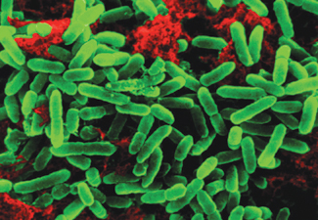
Australian Food Chain
primary consumer
Grass
producers
Wombat
Crocodile
Dingo
decomposer
consumers
Decomposed Bacteria
secondary consumer

Slide 4
How Energy Flows Through Food Chain
The energy is gained from eating.
The grass is the producer of energy, producer of the food chain
Plant eaten by Wombat
Wombat eaten by Dingo
Dingo eaten by Crocodile
Decomposed by Bacteria

Slide 5
Nutrient Cycle
Nutrient cycle is actually a form of matter transfer. It shows how nutrients move through the entire ecosystem.
Carbon Cycle
Nitrogen Cycle

Slide 6
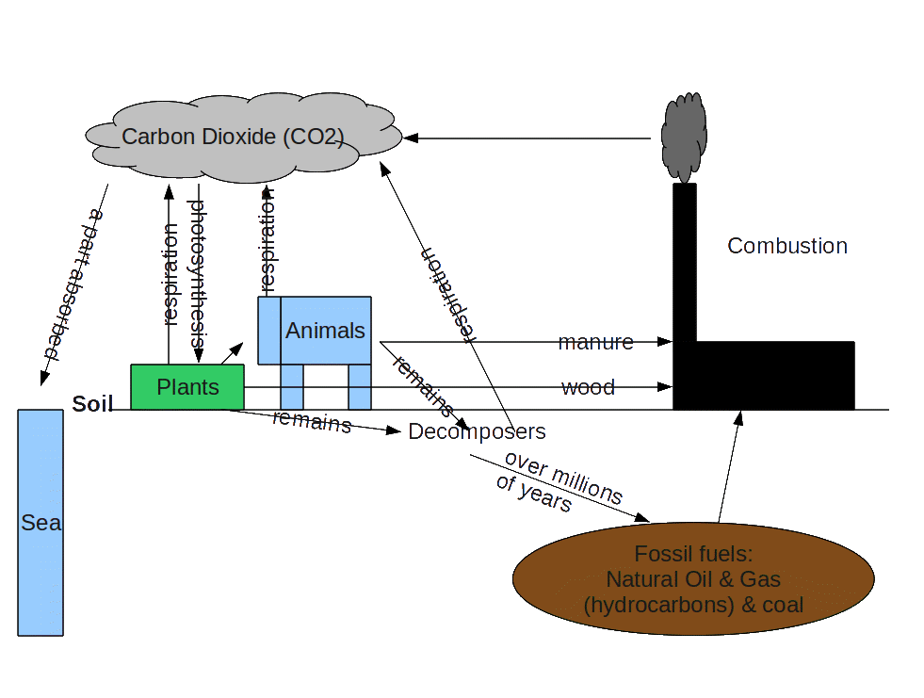
Carbon Cycle Diagram

Slide 7
Carbon Cycle
How carbon circulates in the ecosystem
Has a large impact on global warming
Burning fossil fuel produce greenhouse gass which increase the heat.
Bush fires, Temperature rises, Coral dies, Plants
Burning fossil fuels and cutting trees upset the balance
Absorbed carbon
Released carbon

Slide 8
Nitrogen cycle illustrated
Air (N₂)
Nitrogen Oxides
(NO, NO₂)
Combustion
& Lightning
Nitric acid
(in acid rain)
(HNO₃)
Animals
Fertilizer
Manure
Plants
Soil
Fixing Bacteria
Bacteria
NH₃
(Ammonia)
Bacteria
NO₂
(Nitrite)
NO₃
(Nitrates)
Denitrifying
Bacteria

Slide 9
Nitrogen Cycle
Movement of nitrogen through the ecosystem, converted between its different forms
The cycle:
Nitrogen in soil (nitrates) → absorbed by → plants (amino acids → proteins)
Plants (proteins) → eaten by → animals (digested into amino acids)
Animal waste & organic matter (proteins & amino acids) → decomposition → soil (ammonia → nitrites → nitrates)
Meanwhile:
Bacteria in soil: nitrogen in air (molecular nitrogen) → fixation → soil (ammonia)
Bacteria in soil: nitrogen in soil (ammonia → denitrification → air (molecular nitrogen)
Human activity has changed the cycle
Burning fossil fuels
Application of fertilizer
Causing:
Nutrient imbalance in plants
Algal blooms

Slide 10
Thank You

Slide 11
Reference
"404 - Page Not Fould Error." Food Webs. Gould League. Web. 16 Mar. 2012. <http://www.gould.edu.au/foodwebs/australia.htm>.
Google Images. Google Images. Web. 16 Mar. 2012. <http://www.australianexplorer.com/photographs/animals/australia_zoo_wombat_1.jpg>.
Google Images. Google Images. Web. 16 Mar. 2012. <http://www.australianfauna.com/afimg/dingo.jpg>.
Google Images. Google Images. Web. 16 Mar. 2012. <http://www.kidcyber.com.au/IMAGES/croc_jump.jpg>.
Google Images. Google Images. Web. 16 Mar. 2012. <http://www.earth-cards.com/pseudomonas_bacteria.jpg>.
"Nitrogen Cycle." 301 Moved Permanently. Chemistry and Issues in the Environment. Web. 16 Mar. 2012. <http://www.elmhurst.edu/~chm/onlcourse/chm110/outlines/nitrogencycle.html>.
Kimball, John W. “The Carbon Cycle.” Kimball’s Biology Pages. RCN. Web. 28 Aug 2011. 15 Mar 2012. <http://users.rcn.com/jkimball.ma.ultranet/BiologyPages/C/CarbonCycle.html>
Bernhard, Anne. “The Nitrogen Cycle: Processes, Players, and Human Impact.” Nature.com. Nature Publishing Group. Web. 15 Mar. 2012. < http://www.nature.com/scitable/knowledge/library/the-nitrogen-cycle-processes-players-and-human-15644632>

