Slide 1
Enriching The Fashion
Aditya
Grade 8.1

Slide 2
Western Fashion

Slide 3
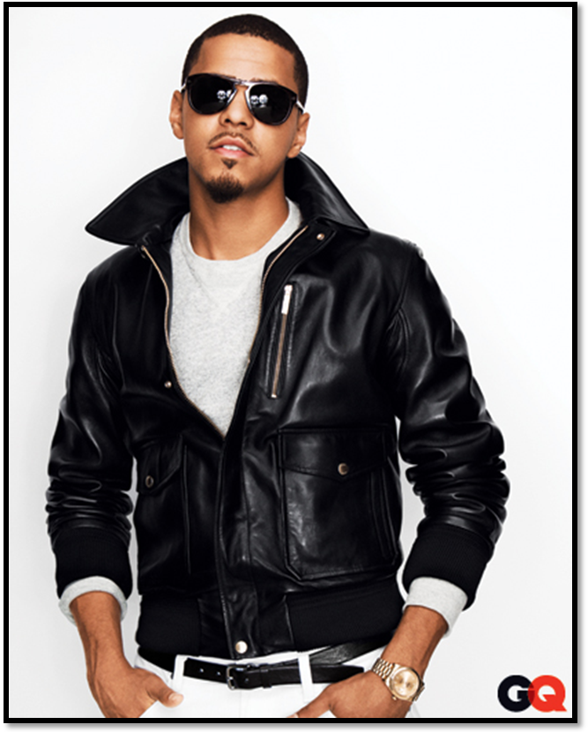
Western Fashion

Slide 4
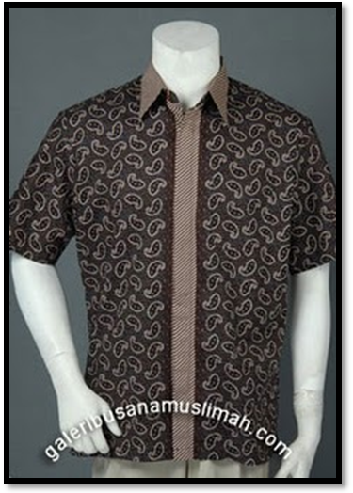
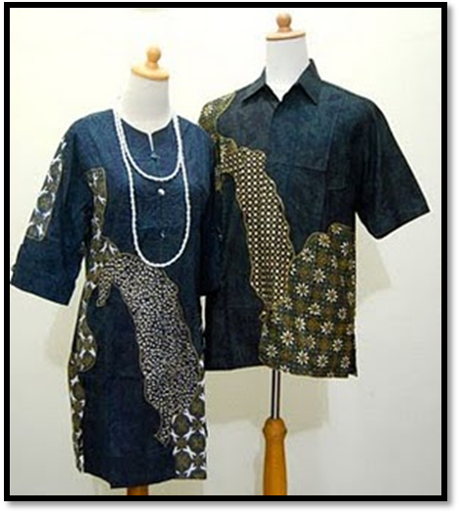
Indonesian Fashion

Slide 5
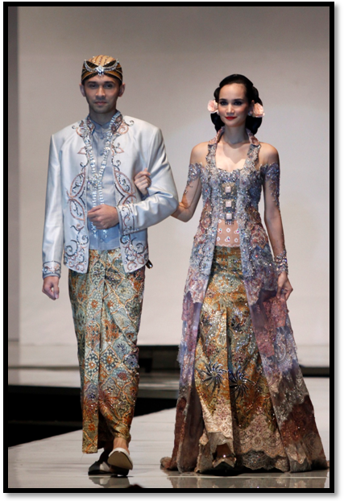
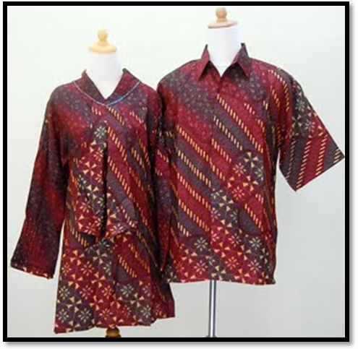
Indonesian Fashion

Slide 6
Similarities
Both type of fashion is mostly made from cloth
There is a design for each set of clothes.
Each fashion has a type of shirt and pants. What I mean is that the shirt and pants are actually covered, like the fashion is some countries where they don’t cover the legs until the knees..
The designs for each costume is very creative, there is more then two colors in a costume.
The fashion for each design is flexible.
Notes:
Both type of fashion is mostly made from cloth, as in the materials that are used in shirts. This is a similarity because some clothes are made from skin or different types of materials. Materials that is unique and eccentric.
There is a design for each set of clothes. Eventhough the motive or type of design is not really the same, at least there is a design. Unlike some fashion that doesn’t consider a motive or picture. The Indonesian fashion sure has more detailed designs that the Western, but both has designs which fill up the clothes.
Each fashion has a type of shirt and pants. What I mean is that the shirt and pants are actually covered, like the fashion is some countries where they don’t cover the legs until the knees. Or the fashion in some countries where they don’t even where clothes, like the early Aborigines. They didn’t even bother to cover their upper body.
The designs for each costume is very creative, there is more then two colors in a costume. Even the Western fashion has a lot of color in each costume, for Indonesian fashion it is obvious how there are a lot of colors.
The fashion for each design is flexible. What I mean by flexiable is that the there can be short sleeve or long sleeve, there can be a collar or no collar. This is quite important because some countries doesn’t have these features, like monks, they don’t have collars at all.

Slide 7
Differences
The Indonesian design, or could be said as motives are more complex then the Wesstern motives.
More motives, the Indonesian surely is more complex. But for design the Western has more variety.
The fashion from the Western is more modern.
For Western fashion, using short pants is still part of fashion while the Indonesian fashion doesn’t accept short pants.
The type of design is very different, not only for the clothes and pants, also for the hats.
Notes:
Both type of fashion is mostly made from cloth, as in the materials that are used in shirts. This is a similarity because some clothes are made from skin or different types of materials. Materials that is unique and eccentric.
There is a design for each set of clothes. Eventhough the motive or type of design is not really the same, at least there is a design. Unlike some fashion that doesn’t consider a motive or picture. The Indonesian fashion sure has more detailed designs that the Western, but both has designs which fill up the clothes.
Each fashion has a type of shirt and pants. What I mean is that the shirt and pants are actually covered, like the fashion is some countries where they don’t cover the legs until the knees. Or the fashion in some countries where they don’t even where clothes, like the early Aborigines. They didn’t even bother to cover their upper body.
The designs for each costume is very creative, there is more then two colors in a costume. Even the Western fashion has a lot of color in each costume, for Indonesian fashion it is obvious how there are a lot of colors.
The fashion for each design is flexible. What I mean by flexiable is that the there can be short sleeve or long sleeve, there can be a collar or no collar. This is quite important because some countries doesn’t have these features, like monks, they don’t have collars at all.

Slide 8
How Can Western and Indonesian Fashion Enrich One Another
They can improve by analyzing their fashion differences.
The motives
More variety
More modern
By analyzing the differences, the Western and Indonesian fashion can improve. They can give input and suggestions to each others differences. Try to make them better, or prove which is better.
Notes:
They can improve by analyzing their fashion differences.
Indonesian fashion which have too much motives can reduce their motives while western fashion which have less motives could increase their motives.
By analyzing the Western fashion, the Indonesians could make different designs, reducing the shiny materials. Making the design more simple rather then using complex designs. Reduce the complex lines and curves.
Indonesian fashion could learn to be more modern, like stop using traditional designs, like sandals. Also with the hats.
By analyzing the differences, the Western and Indonesian fashion can improve. They can give input and suggestions to each others differences. Try to make them better, or prove which is better.

Slide 9
Reference
Andy. Style Scrapbook. 12 Mar. 2012. Web. 12 Mar. 2012. <http://www.stylescrapbook.com/search?updated-min=2012-01-01T00:00:00+01:00>.
Berita Mandiri. Kuceng Group, 24 Feb. 2011. Web. 12 Mar. 2012. <http://www.beritamandiri.com/2011/08/model-baju-batik-modern-terbaru-2011.html>.
Fashionesedaily. Fashionesedaily, 08 Oct. 2011. Web. 12 Mar. 2012. <http://fashionesedaily.com/blog/2011/10/08/indonesian-designers-show-their-best-at-world-batik-summit/>.
"GQ Endorses: The Incredibly Fly Bomber Jacket." GQ. Ben Watts, Oct. 2011. Web. 12 Mar. 2012. <http://www.gq.com/style/wear-it-now/201110/gq-endorses-bomber-jackets>.

Slide 10
Evaluation of Resources
1st Resource= It is valid and reliable, quite biased
2nd Resource = It is not as valid but is reliable, not biased.
3rd Resource = It is valid and reliable, it is not biased.
4rd Resource: It is valid, reliable and not biased.
Notes:
Andy. Style Scrapbook. 12 Mar. 2012. Web. 12 Mar. 2012. <http://www.stylescrapbook.com/search?updated-min=2012-01-01T00:00:00+01:0= it is valied because the picture was posted the day I opened it. It validates because the designs for Western fashion, men and women is pretty much similar. The difference is not large. However it is quite biased because it is from a blog.
Berita Mandiri. Kuceng Group, 24 Feb. 2011. Web. 12 Mar. 2012. <http://www.beritamandiri.com/2011/08/model-baju-batik-modern-terbaru-2011.html>. = it isn’t as valid as the first resource because the picture was posted in February 2011. Yes it is reliable because the picture was a type of batik, maybe not batik but it has the indonesian motives and design. It wasn’t quite biased because it was about a Indonesian fashion report.
Fashionesedaily. Fashionesedaily, 08 Oct. 2011. Web. 12 Mar. 2012. <http://fashionesedaily.com/blog/2011/10/08/indonesian-designers-show-their-best-at-world-batik-summit/>. = It is quite valid because the picture was posted in 2011 October. The picture is reliable because the picture or fashion given is batik, there is for man and women. The pictures weren’t distincly different from the other resources I found about Indonesian culture. The website isn’t biased because it is a official fashion website.
"GQ Endorses: The Incredibly Fly Bomber Jacket." GQ. Ben Watts, Oct. 2011. Web. 12 Mar. 2012. <http://www.gq.com/style/wear-it-now/201110/gq-endorses-bomber-jackets>. = It is valid because the picture was posted in October 2011. The picture is reliable because after comparing the pictures from other website, it mostly is similar. The resource isn’t biased because it is an official men fashion website.

