Slide 1
Science Assesment
Aditya.W 8.1

Slide 2
What is the problem/issue?
The problem or global issue relevent to my topic is that canoeing is a very enjoyable and exiciting sport but there were few disadvantages.
Expensive because you have to rent a canoe, or buy the canoe, even transporting your personal canoe would be really difficult.
Yes they may be previous portable canoes but those boats are just too heavy and weight at least 18 kilograms.
How would you carry that around? Not efficient at all.

Slide 3
What Scientific Invention was Made?

Slide 4
The Foldable Canoe
That is the foldable canoe or known as the Adhoc.
The invention was finished at August 5th 2011 by a Israeli designer named Ori Levine.
It is only 4.1 kg and much more efficient. It can fit into a backpack and be assembled in 15 minutes.
Although it is a single seater, it is really impressive.
The structure is supported by a carbon fiber frame and the canoe itself is based on aramid fabric which is the material for sail boats.
However the fact of how much weight it can withstand is unknown because it simply floats with only one person on it.

Slide 5
Creator of the one seated canoe the Adhoc, Ori Levine

Slide 6
How does it help with the issue?
The Adhoc, foldable canoe is very essential with the issue because it is much lighter.
Can be backpacked.
No need to rent or transport your own canoe.
We can reduce creating the tradisional wood canoes from the old times although creating the Adhoc was not intended to accomplish that.
Hitch hikers and backpackers can just carry it with them while traveling in case of a emergency.

Slide 7
What’s so Special?
Like I said, it can be brought much more efficiently.
Only 4.1 kilograms rather then 18 kilograms.
No need to use to tradisional one unless you want a two seater.
It is made from unique materials which is why it is light. Materials are like carbon fiber frame which support the structure.
It may not be sold yet but once it is travelers will definitely need one because during their travels, there must be lakes or rivers which must be crossed. But comparing with the tradisional one, the Adhoc would be more expensive for it is still new.

Slide 8
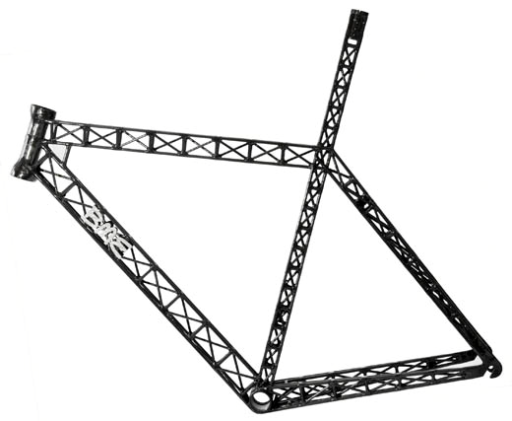
Essential materials in the Adhoc

Slide 9
Positive Effects to Environment, society and people..
The effects to society and people are basically the same. The effects are like we don’t need to buy or rent the old canoe because that is what the people used to do.
Hikers can travel more effieciently because they have a canoe just inside their backpack.
There won’t be a need to transport your own canoe with a truck or other vehicles.
As for the environment, the positive thing is that we don’t need to cut anymore trees to make the tradisional canoe. Having more trees will save the earth so the Adhoc also helps the environment.

Slide 10
Negative effects to Environment, society and people...
Negative impacts to both people and society is that the material of the Adhoc isn’t as strong as the tradisional one so if something happens, the Adhoc can break.
Hikers/travelers can drown.
The price of the Adhoc is more then the price of the normal canoe which can effect the customer’s decision in purchasing it.
There isn’t much of a negative impact to the environment because the Adhoc doesn’t use oil or gas, it uses human power.

Slide 11
Video of Adhoc...

Slide 12
Factors - Environment
It actually improves the environment because we won’t need to use the old tradisional wooden canoe which uses trees.
It won’t polute the environment in any way because it will be brought back to your own backpack.
It won’t polute the environment even when you are canoening because there is no chance to fish, eat or spill anything while canoeing because manoeuvreing it is already a challenge.
The only way it will endanger the environment is that if the Adhoc has a certain point where it won’t work and people are forced to use the tradisional wooden canoe again.

Slide 13
Factors - Society
The Adhoc definitely is relevent with the society because the explanations I have been telling is about the society.
Travelers/hikers can travel more efficiently.
We won’t need to use the tradisional canoe, no need to rent the old or buy the tradisional canoe anymore.
There won’t need to transport the 18 kiligram canoe into a lake. You could just carry it with your hands.

Slide 14
Factors - Economy
There may be not definite price yet, distributors or the release date but the Adhoc is much more efficient then the tradisional canoe.
When it releases, the ones who would need one would be hikers, travelers and those with the hobby of canoeing.
It will indeed be famous and the distributors will gain money but there is a disadvantage. The ones who sell the tradisional canoe will not have customers anymore which certainly effects the economy.

Slide 15
Sources
"Foldable Canoe Picture." GizMag. Web. 12 Aug. 2011. <http://images.gizmag.com/hero/adhoc.jpg>.
Coxworth, Ben. "Superlight Folding Canoe Fits in a Backpack." Gizmag | New and Emerging Technology News. Web. 11 Aug. 2011. <http://www.gizmag.com/light-folding-canoe-in-backpack/19448/>.
"Interesting New Products and Inventions: Foldable Canoe." IdeaConnection: Solve Your Open Innovation Challenges. Web. 11 Aug. 2011. <http://www.ideaconnection.com/new-inventions/foldable-canoe-04895.html>.
Tyrsina, Radu. "Take-away Canoe Fits in Backpack, Assembles in under Five Minutes - Mobile Magazine." Mobile Magazine - Gadgets, Mobile Phones, Tablets, All the Cutting Edge Tech You'd Expect. Web. 14 Aug. 2011. <http://www.mobilemag.com/2011/07/30/take-away-canoe-fits-in-backpack-assembles-in-under-five-minutes/>.
Google Images. Web. 14 Aug. 2011. <http://www.fibermaxcomposites.com/shop/images/K300T2.jpg>.
Google Images. Web. 15 Aug. 2011. <http://uncledutchfarms.com/wp-content/uploads/2011/01/boytv.jpg>.

Slide 16
Thank You

