Slide 1
God’s Big Picture
Aditya.W

Slide 2
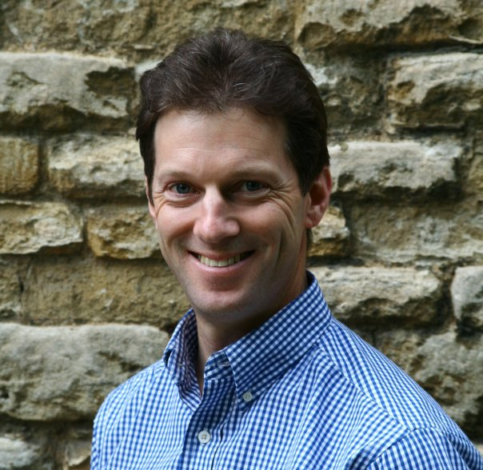
What was our Task?
Our assignment was to make a powerpoint regarding a book called God’s Big Picture writen by Vaughan Roberts. We were given a specific section.

Slide 3
God is the Author of Creation
I got section 1 , the title was “God is the Author of Creation”. The part was basically about how God created the entire world and heavens. The book tells that no matter if He created everything in six literal days or not; what’s important is that He is the creator of everything.
The book explains that God not only looks in our souls, but also see our bodies. The section explains that God has a plan for us in heaven. It explains that He will grant us salvation in heaven.

Slide 4
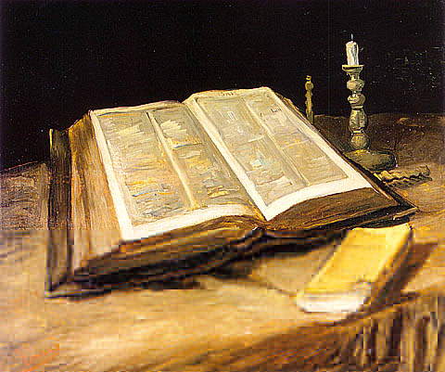
Bible Verse
Genesis 1:1 = In the begining God created heavens and the earth.
John 1:1-3 = In the begining was the Word, and the Word was with God, and the Word was God. He was with God in the begining. He was with God in the begining. Through him all things were made; without him nothing was made that has been made.
John 12:31 = Now is the time for benefit, not mine.

Slide 5
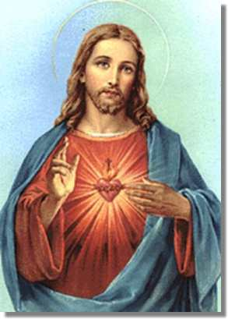
Meaning of Verses
Genesis 1:1 = It tells how God created the heavens and the earth.
John 1:1-3 = Tells that God created the world by speaking his Word. His Word is very powerful and will always belong to Him.
John 12:31 = It tells that we should benefit the time we have in His world.

Slide 6
Conclusion
As a conclusion, the section I got was more or less about God becoming the creator of everything.
It doesn’t matter it took him 7 literal days or not. We should still respect Him like the way we did.

Slide 7
Thank You

