Slide 1
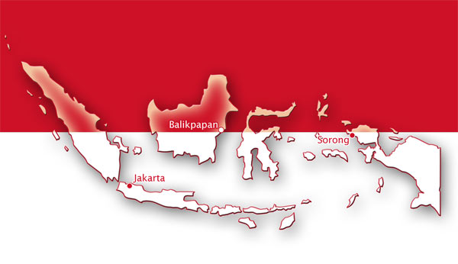
Indonesian Traditional Songs
Aditya. W
Music

Slide 2
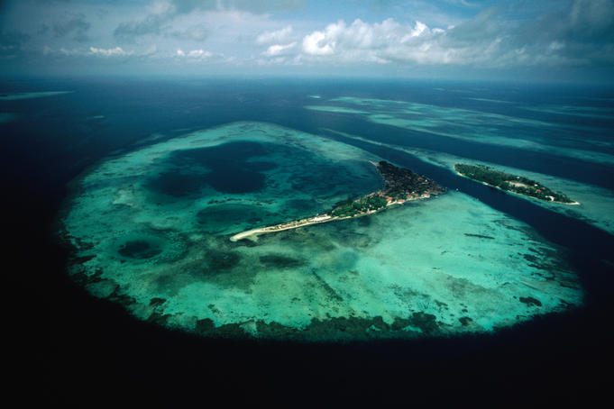
Indonesia
Indonesia is a archipelago consisting 17,500 islands.
33 provinces each with diverse culture and traditions.
238 million people, 4th in the world
583 language and dialects.

Slide 3
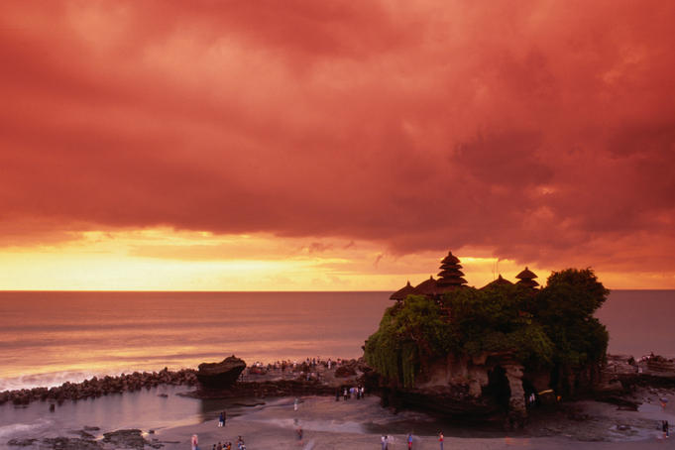
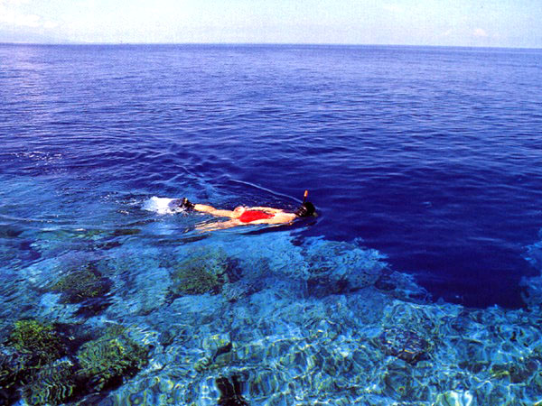
Bali
A tropical paradise
Beaches provide superb entertainment
Swimming, surfing, snorkling, diving
Interesting culture: art, dance, and music.
A unique musical instrument from Bali would be Gamelan. They are like gongs.
Janger is a Balinese traditional song
Maluku
Tanah Lot, Sea Temple
The spice islands, rich with cloves and nutmeg.
Remote place, great entertainment
Snorkling, great beaches, exploring vocanoes and ruined Dutch fortresses
Talented with their art: dance and music
Rasa Sayange, a traditional song from Maluku.
Hunimoa Beach, Ambon

Slide 4
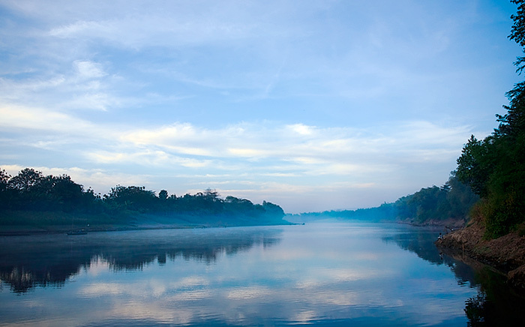
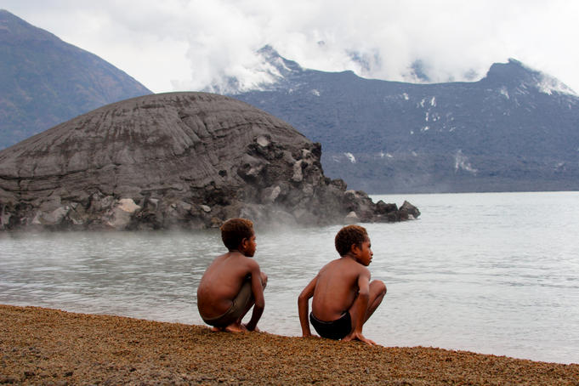
Indonesia
Surely has a fascinating culture
Art surrounds the nation
Countless traditional music and instruments
Various unique landmarks: Borobudur, Prambanan
Rich with forest’s and rivers
Bengawan Solo
A country diverse in all aspects
One of the most exotic provinces
Papua is different then other provinces, it’s like exploring a new land
Complex cultures
Home of many unique things: the bird of paradise and the traditional song Yamko Rame Rambo.
Papua
Mt Tuvuvur near Rabaul

Slide 5
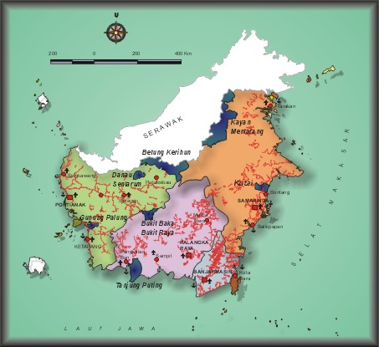
Kalimantan
A land rich with both culture and nature
Home for 13,7 million people
The island Borneo: Kalimantan, Malaysia, Brunei

Slide 6
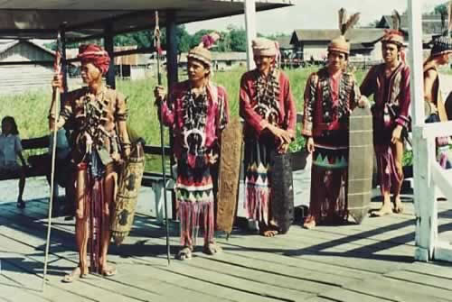
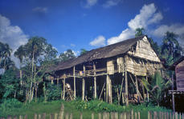
Dayak, The Natives
They came 3,000 years ago, the Borneo indegenous people.
There are 200 sub tribes, each with their own culture, dialects and customs.
The longhouse, still preserved up to now.

Slide 7
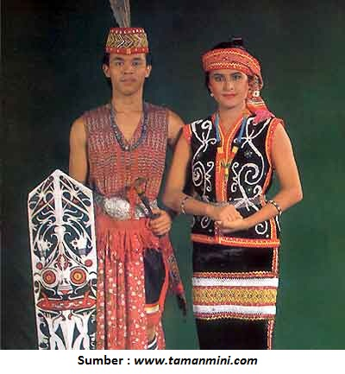
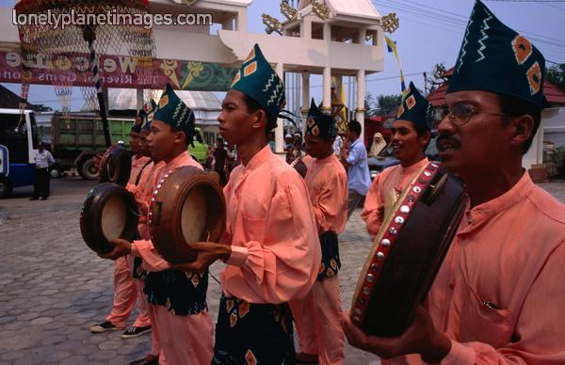
Culture and Art
Tepung Tawar Ceremony: To welcome and protect visitors. Followed by music and dance
Belian Ceremony: The ceremony for healing diseases
Kelebur Bejamug: A ceremony for guests who are going to leave
West Kalimantan Garments
Traditional Songs: Cik-Cik Periuk, Ampar-Ampar Pisang

Slide 8
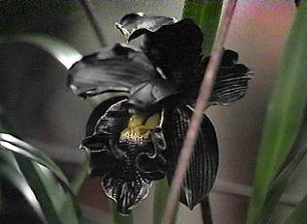
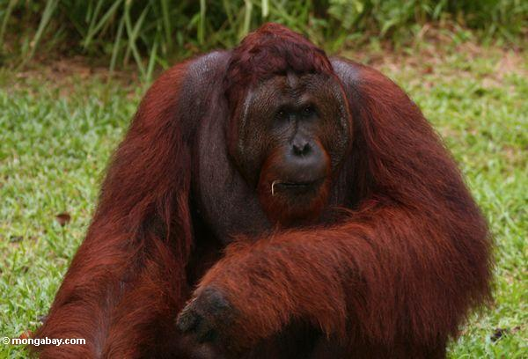
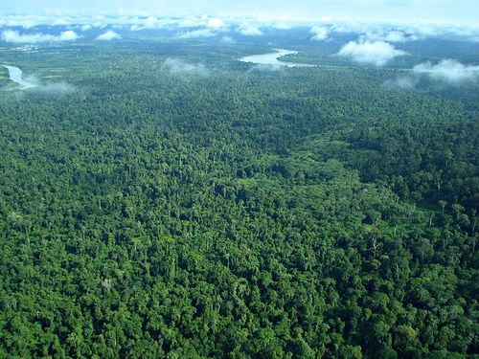
Nature and Wildlife In Kalimantan
The rainforest in Kalimantan is full of unique flora and fauna
Endangered animals
Exotic plants, the rare Black Orchid (Colongenia Pandurata) and the Rafflesia.

Slide 9
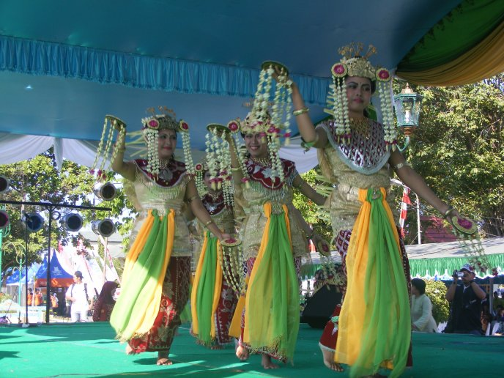
Ampar-Ampar Pisang
A Kalimantan traditional song
Thamrin, the composer but released by Hamiedan AC
One of the most prosperous songs from Banjar
Children usually use it for their games
The song is used in dances
No traditional rituals are involved with this song

Slide 10
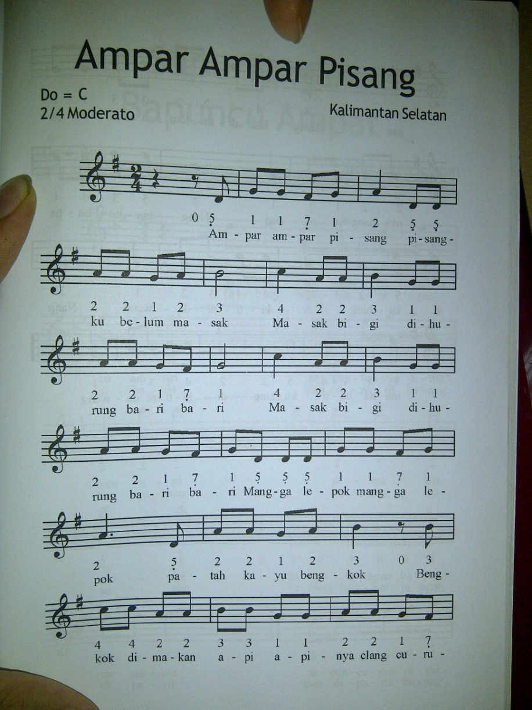
Ampar-Ampar Pisang
Listen

Slide 11
Analysis
First finger is C or Do
Played in a major scale
Treble Clef
Time signature 2/4 (2 beats in a bar)
Tempo: Moderato
Articulation: No staccato symbols, little bit of legato
Pitch: High
Dynamics: Giocoso
Notes: No whole note, half notes and quarter notes
Rests: No whole rest, half rest and quarter rest

Slide 12
Reference
Web
"Indonesia." Lonely Planet. N.p., n.d. Web. 31 July 2012. <http://www.lonelyplanet.com/indonesia>.
"Maluku (Moluccas)." Lonely Planet. N.p., n.d. Web. 31 July 2012. <http://www.lonelyplanet.com/indonesia/maluku-moluccas>.
"Bali." Lonely Planet. N.p., n.d. Web. 31 July 2012. <http://www.lonelyplanet.com/indonesia/bali>.
"Kalimantan - Indonesia's Part of Borneo Island." Kalimantan - Indonesia's Part of Borneo Island. N.p., n.d. Web. 01 Aug. 2012. <http://www.indonesiapromo.com/borneo.html>.
"Visit East Kalimantan." : Traditional Ceremonies. N.p., n.d. Web. 02 Aug. 2012. <http://visiteastkalimantan.blogspot.com/2007/08/traditional-ceremonies.html>.
Pictures
http://media.lonelyplanet.com/lpi/9551/9551-2/681x454.jpg
http://gigihpratomo.files.wordpress.com/2012/05/peta-indonesia.jpg
http://media.lonelyplanet.com/lpi/2867/2867-4/681x454.jpg
http://indonesiacountry.com/wp-content/uploads/2010/03/maluku11.jpg
http://1.bp.blogspot.com/-YqN0Tik8QF8/Thh6o5YzF_I/AAAAAAAAAAY/0CG_C6GE4Sw/s1600/bengawan-solo.jpg
http://media.lonelyplanet.com/lpi/26019/26019-15/681x454.jpg
http://www.dephut.go.id/INFORMASI/TN%20INDO-ENGLISH/image/tn_kalimantan.jpg
http://www.floressatours.com/indonesia-pictures/images/kalimantan_paul06_jpg.jpg
http://farm5.static.flickr.com/4018/4258128013_fe36728b77.jpg
http://www.mongabay.com/images/indonesia/kalimantan/kali9519.JPG
http://3.bp.blogspot.com/_tWqLEoxN6XE/SjWsdXySG5I/AAAAAAAAAHw/Cua-pdvaVmY/s400/black+orchid.jpg
http://www.azamku.com/wp-content/uploads/2012/03/pakaian-adat-dayak-kalimantan-barat-pakaian-tradisional-dayak-kalimantan-barat-kalbar.jpg
http://4.bp.blogspot.com/_OUXRHvMHMZI/SzVxLu-ezPI/AAAAAAAAAYU/ge7V0SrRg4Y/s400/21567_1167843484631_1484262686_395951_2438144_n.jpg
http://hasanzainuddin.files.wordpress.com/2008/06/tari.jpg?w=688&h=516

