Slide 1
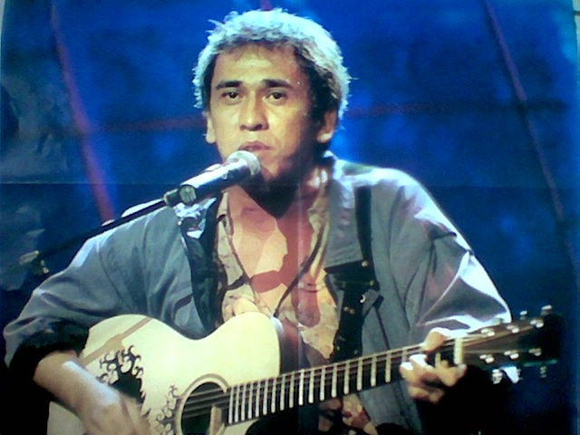
Iwan Fals
Aditya Wikara
Music Theory - 10.1
http://www.bubblews.com/assets/images/news/184403693_1369706822.jpg

Slide 2
Biography
Virgiawan Listanto
Jakarta, 3 September 1961
Born to Harsoyo (soldier) and Lies Suudijah
Local eduation, Jakarta Arts Insitute
Age of 13, he performed at the streets, weddings and other social events
Extremely hard working, perserverence, used his talents to the fullest, high sense of nationalism
He wrote music about social injustice in Indonesia

Slide 3
Biography
Age 18, he formed his first group named Amburadul. Released a few albums but weren’t very successful
Iwan Fals went to solo career
1981,signed Musica Studio, first album Sarjana Muda.
Total of 37 albums
Folk, country, pop singer
Wrote countless protest music
Compared to Bob Dylan
2002, named as Great Asian Hero by Time Magazine.

Slide 4
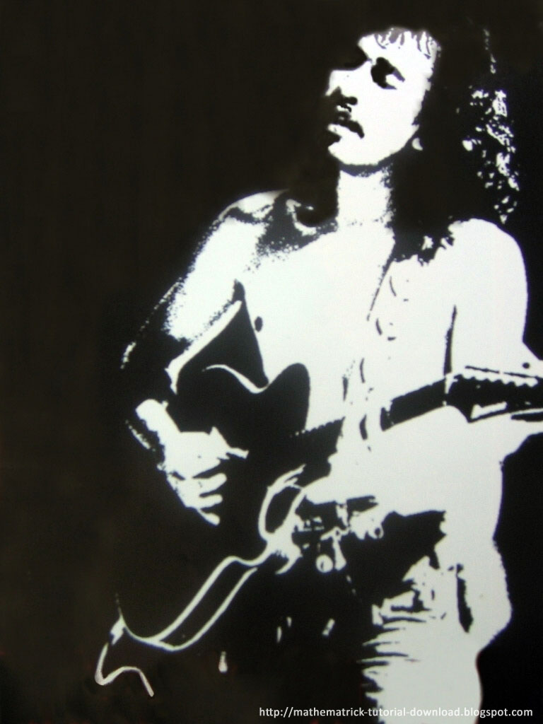
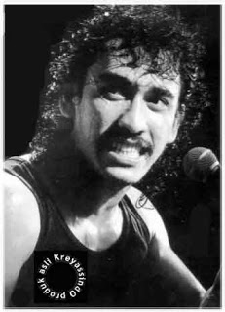
Song – Guru Oemar Bakri
http://3.bp.blogspot.com/-L-TujF4yVhc/UTlk-NF4XKI/AAAAAAAAAzg/vIeOHgHeVm4/s320/iwan-fals.jpg
http://en99oe.files.wordpress.com/2011/07/iwan-fals-17.jpg

Slide 5
Lyrics
Tas hitam dari kulit buaya "Selamat pagi!", berkata bapak Oemar Bakri "Ini hari aku rasa kopi nikmat sekali!" Tas hitam dari kulit buaya Mari kita pergi, memberi pelajaran ilmu pasti Itu murid bengalmu mungkin sudah menunggu (*) Laju sepeda kumbang di jalan berlubang S'lalu begitu dari dulu waktu jaman Jepang Terkejut dia waktu mau masuk pintu gerbang Banyak polisi bawa senjata berwajah garang Bapak Oemar Bakri kaget apa gerangan "Berkelahi Pak!", jawab murid seperti jagoan Bapak Oemar Bakri takut bukan kepalang Itu sepeda butut dikebut lalu cabut, kalang kabut, cepat pulang Busyet... Standing dan terbang Reff. Oemar Bakri... Oemar Bakri pegawai negeri Oemar Bakri... Oemar Bakri 40 tahun mengabdi Jadi guru jujur berbakti memang makan hati Oemar Bakri... Oemar Bakri banyak ciptakan menteri Oemar Bakri... Profesor dokter insinyur pun jadi Tapi mengapa gaji guru Oemar Bakri seperti dikebiri
Black bag of crocodile leather
"Good morning!", Said Mr. Bakri Oemar
"These days I think once delicious coffee!"
Black bag of crocodile leather
Let's go, teaching science
It bengalmu students may have to wait
Rate moped in the potholes
Till We Meet Again so from the first time the Japanese era
Surprised he would enter the gate time
Many faced fierce police carry guns
Mr. Bakri shocked Oemar what the hell
"Fighting sir," replied the student as hero
Mr. Bakri fear absurdly Oemar
It accelerated battered bike and pull, scrambling, quick return
Busyet ... Standing and fly
Reff.
Oemar Bakri ... Bakri Oemar servants
Oemar Bakri ... Bakri Oemar 40 years of service
So honestly devoted teacher did eat liver
Oemar Bakri ... Oemar Bakri made ​​many ministers
Oemar Bakri ... Became professor doctor engineer
But why teacher salaries Oemar Bakri like circumcised
20-2.20

Slide 6
Song Transcription
Scale : Major scale
Key Signature : A (3 sharps)
Time Signature : 4/4, simple duple
Dynamics : piano, mezzo piano, mezzo forte, forte, cresc, dim, etc
Tempo: Allegretto, moderately fast
Form: Repetitive, verse chorus
Timbre (tone color) : violin, guitar, drums, piano, one voice

Slide 7
Song Analysis: Guru Oemar Bakri
Guru Oemar Baktri – Name of a teacher
Protest song on teacher’s pay check, social injustice
Teacher’s are paid poorly but are respoinble for educating people who will be successful and well paid.
It shows nationalism, that he cares towards the lower class society
Song is quite cheerful and happy which sorta clouds the message, however it seems Iwan’s is protesting with fun.
Song shows Iwan’s true self, his sense of nationalism, that he wants to protest.
The upper class people hated him, politicians hated him.

Slide 8
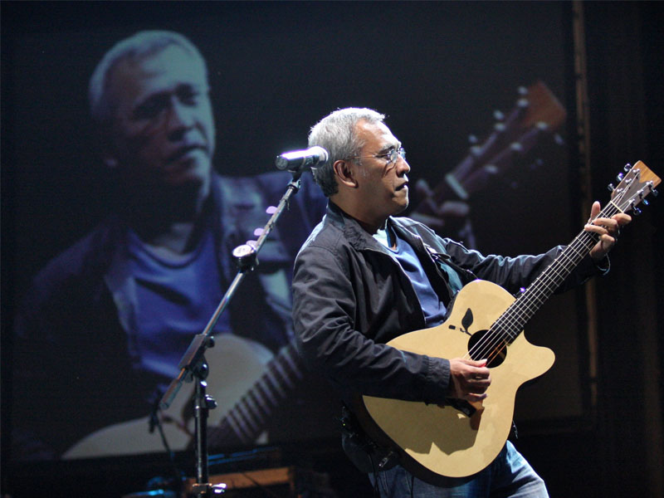
Conclusion
A great artist
Very successful
Wrote many meaningful songs
Had a high sense of nationalism
http://pancamr.lecture.ub.ac.id/files/2012/07/biografi-iwan-fals.jpg
http://bonnernetwork.pbworks.com/f/1215007500/socialjustice.jpg

Slide 9
Bibliography
"Biografi Iwan Fals | Biografi." Biografi Iwan Fals | Biografi. 2011. Web. 06 Oct. 2013. <http://info-biografi.blogspot.com/2013/03/biografi-iwan-fals.html>.
Dominicus, Rinto. "Iwan Fals Interview." Personal interview. 5 Oct. 2013.
"Iwan Fals: The Voice of Social Justice in Indonesia." PRIs The World RSS. Medtronic Foundation, Bill & Melinda Gates Foundation, 14 Jan. 2013. Web. 17 Sept. 2013. <http://www.theworld.org/2013/01/iwan-fals/>.
"KapanLagi.com: Lirik Iwan Fals - Guru Oemar Bakri." KapanLagicom Atom. KapanLagi.com, 2013. Web. 28 Sept. 2013. <http://lirik.kapanlagi.com/artis/iwan_fals/guru_oemar_bakri>.
Sedyawati, Edi. "Modern and Experimental Indonesian Music." Performing Arts. Singapore: Archipelago, 1998. 126-27. Print.

Slide 10
Thank You

