Slide 1
Land Degradation
Aditya
8.1
humanities

Slide 2
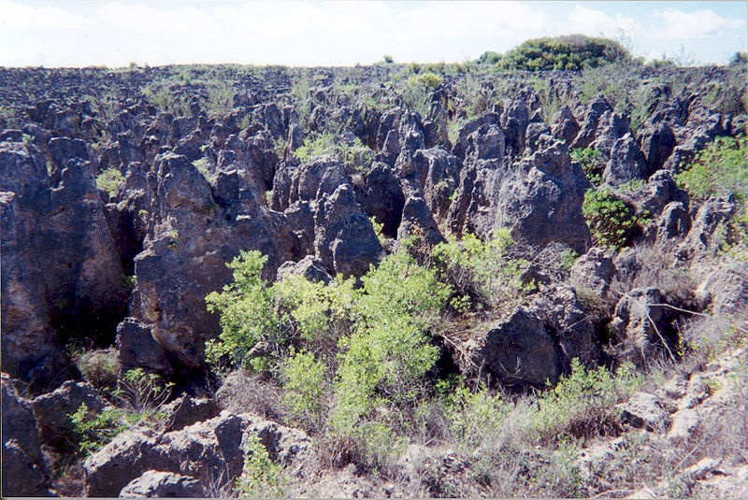
Introduction
Land degradation is the process of decreasing the quality of land, it’s topsoil, vegetation, water resources caused usually by excessive exploitation. These incidents usually occur due to human activity. The picture on the right is the land degradation of phosphite. That is the remains of the mining.

Slide 3
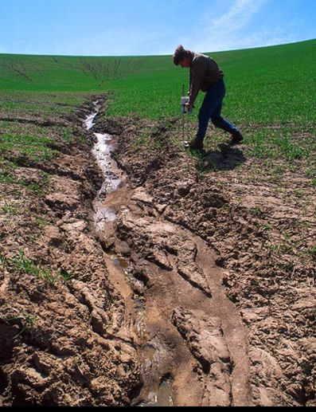
Land Degradation
Land degradation has been considered to be one of the most important issue of the 21st century due to the damage in agronomic productivity, the environment and its effect on food. It has been estimated that up to 40% of the world’s agricultural land is seriously degraded.

Slide 4
Major Causes of Land Degradation
Land clearance or known as deforestation.
Decrease of soil nutrients due to poor farming actions.
The overgrazing of livestock.
Land pollution which includes industrial waste.
When vehicles do off-roading.
Excavation/quarry of stone, sand, ore and other minerals

Slide 5
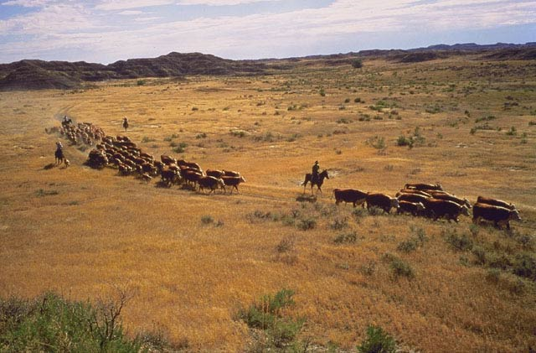
Effects of Land Degradation
The main effect of land degradation is that the productivity of the land will be reduced.
For example with soil, the structure will be loss and all the nutrients will be reduced.
Overcutting vegetation will result in difficulty in finding timber, fuelwood and others.
There are many other effects such as soil erosion, water erosion and wind erosion.

Slide 6
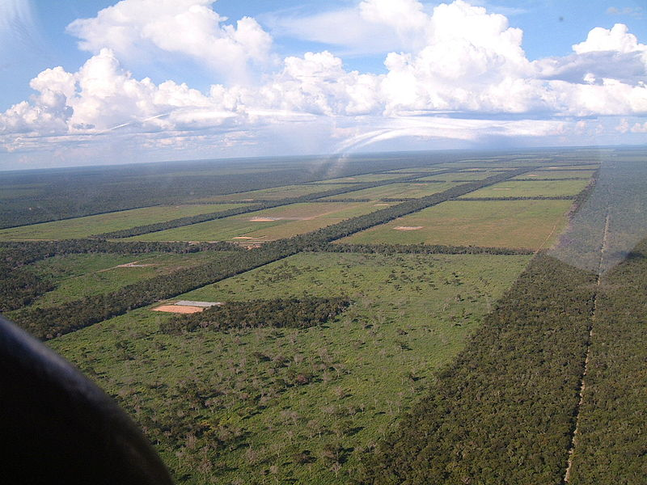
Countries With Land Degradation
Afghanistan- severe overgrazing
USA- soil erosion
Nauru- excavation of phosphate
India- irrigation of crops
Kenya- degraded lands showing erosion
Mexico- severe burning of forests
Paraguay- severe deforestation

Slide 8
Bibliography
"Land Degradation." Wikipedia, the Free Encyclopedia. Web. 10 Feb. 2012. <http://en.wikipedia.org/wiki/Land_degradation>.
"What Is Land Degradation? Definition and Meaning." BusinessDictionary.com - Online Business Dictionary. Web. 14 Feb. 2012. <http://www.businessdictionary.com/definition/land-degradation.html>.

Slide 9
Thank You

