Slide 1
original composition
Aditya wikara
10.1
16th December 2013

Slide 2
The song
Musical Piece, piano, no lyrics
78 Measures
Not too simplistic, pattern of ups and downs, repetitive, diversity
Title: The Wave’s Calling
Theme: Mood Swings

Slide 3
The song - elements
Key Signature: F Major
Scale: Major
Treble & Bass Clef – Melody & Chords
Time Signature: ¾
Meter: Complex duple
Form: Repetitive

Slide 4
Elements
Tempo: Allegreto, little slower than allegro
Rhythm: Slow, not too fast
Texture: Homophonic
Dynamics:
Piano
Mezzo Forte, Forte, Fortissimo
Crescendo, Diminuendo

Slide 5
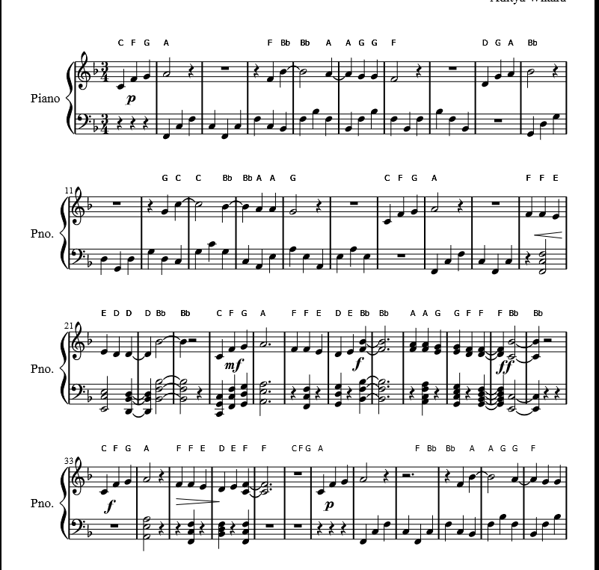
elements
Chords:
Arpeggio
Minor/Major
Inversion
Exampes
F Major
B Flat Major
C Minor
F Major 2nd Inversion
G 7th mm

Slide 6
Thank you

