Slide 1
Original Music Composition
Aditya
9.2
Music theory

Slide 2
Original Composition
Title: The Nature Song
Theme: Nature
Nature song on children’s point of view
Possible Ideas:
World Peace
Friendship
Lost

Slide 3
Process
The Melody
Then Lyrics
New Melody

Slide 4
Lyrics
Mountain so big so mighty
Ocean so blue and vast
Sky so clear and pretty
Gardens their filled with grass
Rivers they flow so freely
Valleys so wide and green
Glaciers so cold and icy
Deserts they give intense heat
These are what God have made
How wonderful He actually is
God is our almighty creator
We should be thankful for what He gives

Slide 5
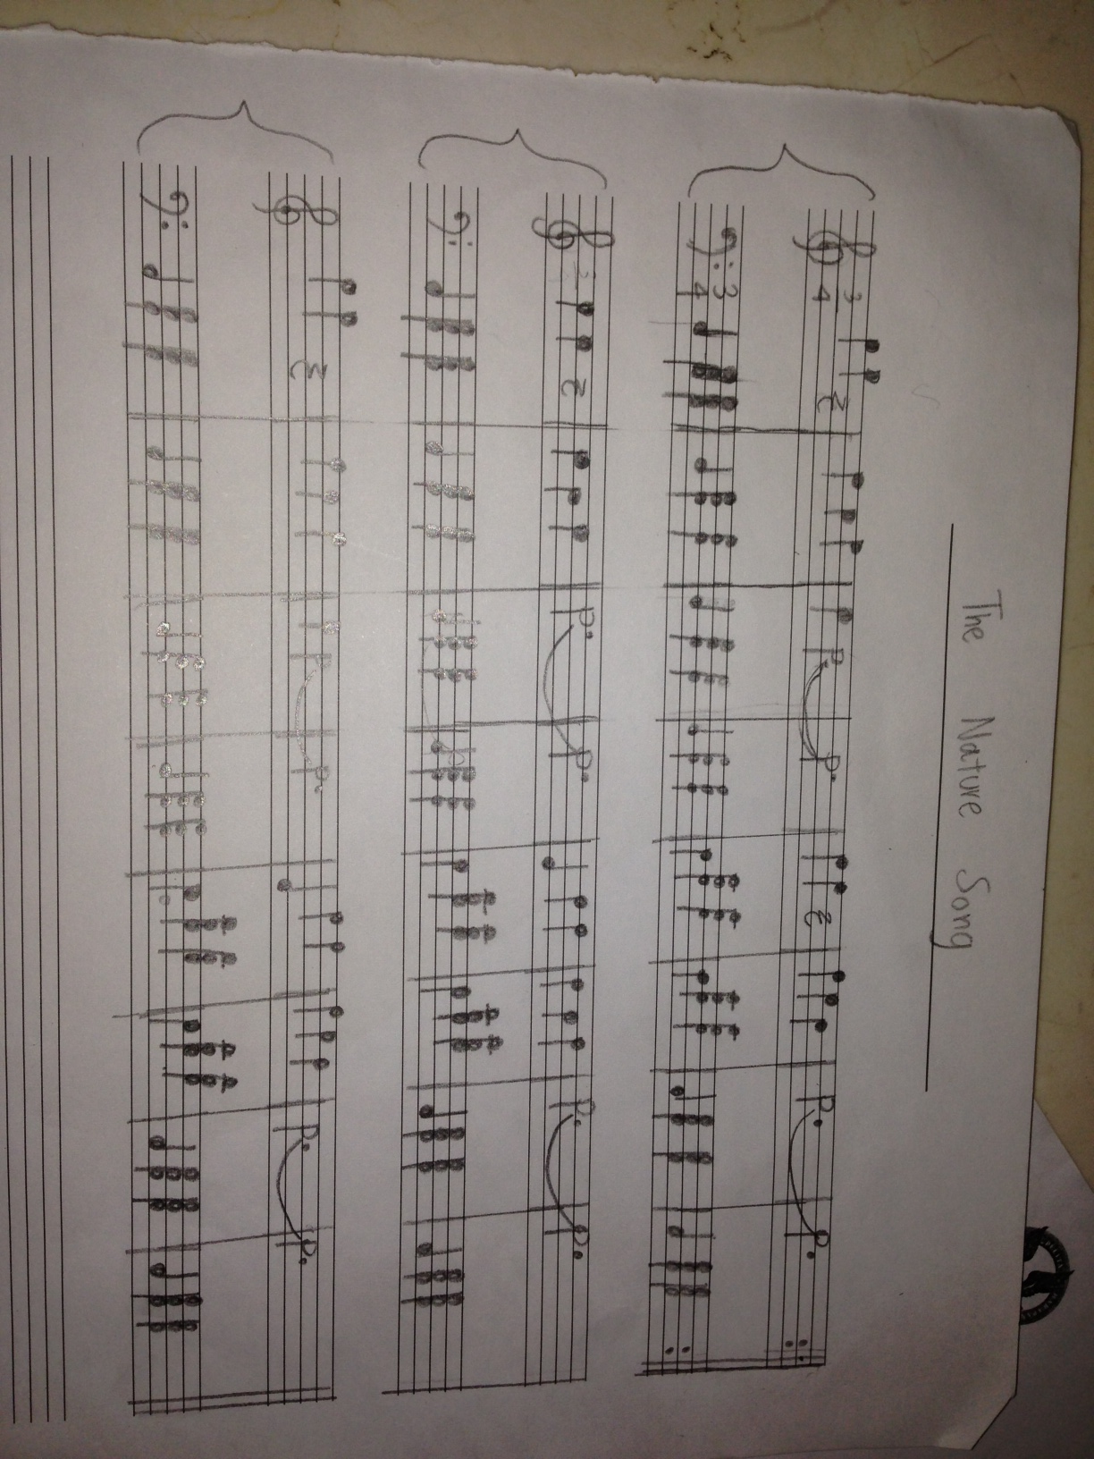
Music Sheet

Slide 6
Video

Slide 7
Evaluation
Product/Result
Played/sung well
Lyrics/Melody
80 – its simple.
Too many bars, had to cut. “Killing yourr own son.”
Process
Feedbacks were useful
Lyrics before melody
Reduce complicating chords
Focus more
Evaluation
Change the song type
Make it shorter
I sing it myself

Slide 8
Thank You

