Slide 1
Renaissance Music
Aditya.W

Slide 2
Content
Introduction
Renaissance Music
Characteristics of Renaissance Music
List of Composers
Josquin des Prez
Career
List of Composition
Sample of Composition
Bibliography
Thank You

Slide 3
Introduction
A type of European music writen during the Renaissance.
Renaissance means rebirth, so renaissance music means the rebirth of music.
The Renaissance period started at the early 1450s and ended at the 1600s.
Cities like Florence or Italy were growing greatly. Great economy and art. It was a perfect time for a new musical age.

Slide 4
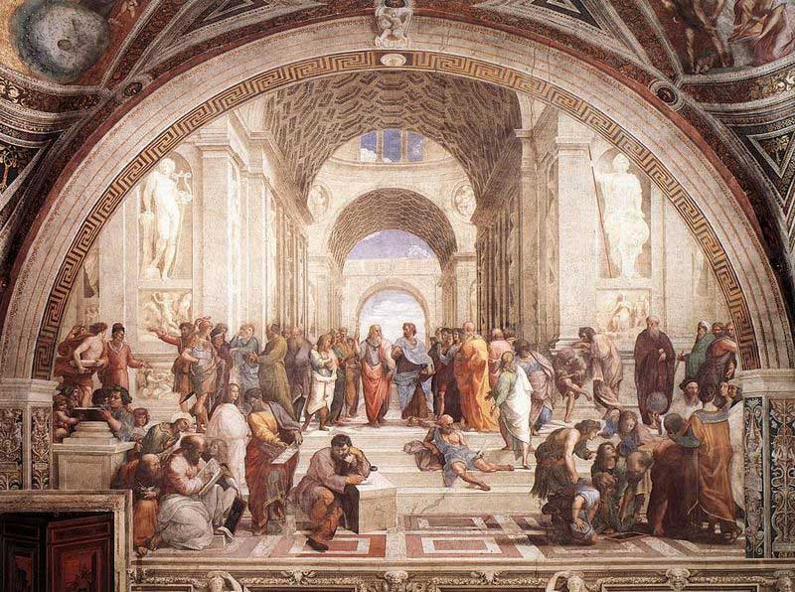
Renaissance Music
People were very aware of art.
Wealthy families like Midici spent high amount of money for art.
Two main types of music during the Renaissance:
Sacred Music – church music, more to the religious side.
Secular Music – opposite of sacred music, focuses more to entertain others.
Example of sacred music would be Machaut’s Agnus Dei. A famous composer who wrote secular music would be Josquin Des Prez.

Slide 5
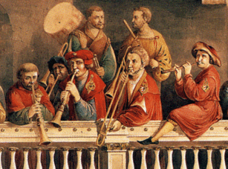
Characteristics of Renaissance Music
Music was writen to improve the emotion and the meaning of the text.
Although sometimes the emotion is very high, there is always ballance between harmony, tone colour and rhythm.
Renaissance music is mostly polyphonic (two or more sounds in one piece)
Homophonic was mostly used in the medieval times.

Slide 6
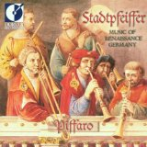
List of Composers
Adam of Fulda
Lodovico Agustini
Alexander Agricola
Martin Agricola
Gregor Aichinger
Alonso Perez de Alba
Cosmas Alder
Jeronimo de Aliseda
Alonso
For Complete List

Slide 7
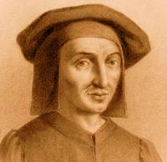
Josquin Des Prez
One of the most famous composers.
Born in Duchy of Burgundy, modern Belgium during 1450s and died at 1521.
He was deeply famous for his chansons or masses. Or could be said as secular music and sacred music.
He was praised by scolars and many writers wrote about him.

Slide 8
Career
His career was focused at France, Milan and Rome.
France – 1480 to the Sforza family
Milan – 1483 also the Sforza
Rome – 1489 until 1495 he worked under Pope Innocent VIII in the papal choir then Borgia Pope Alexander VI.
Carved at Sistine Chapel, it tradition for composers/singers.
Milan he improved secular and Rome improve sacred music.

Slide 9
List of His Composition
Missa Ave Maris Stella (4 voices, Rome, 1486–1495)
Missa de Beata Virgine (5 voices)
Missa Di dadi (=N’aray je jamais) (4 voices; authorship doubted by some scholars)
Missa Faisant regretz (4 voices)
Click for full composition.

Slide 10
Christe Filli Dei
Click for Music Sheet
Below for Mp3

Slide 11
Bibliography
Bibliography
"Renaissance Muisc." Sound Juction. Web. 12 Apr. 2011. <- http://www.soundjunction.org/renaissancemusic.aspa>.
"Renaissance Music." Wikipedia, the Free Encyclopedia. Web. 14 Apr. 2011. <http://en.wikipedia.org/wiki/Renaissance_music>.
Green, Aaron. "Top 8 Renaissance Composers - Popular Renaissance Composers." Classical Music at About.com - Classical Music for Beginners and Experts Alike. Web. 17 Apr. 2011. <http://classicalmusic.about.com/od/renaissanceperiod/tp/renaissancecomp.htm>.
"Renaissance Charateristics." Think Quest. Web. 2 Apr. 2011. <http://library.thinkquest.org/27927/Renaissance_Characteristics.htm>.
"Secular Music." Wikipedia, the Free Encyclopedia. Web. 3 Apr. 2011. <http://en.wikipedia.org/wiki/Secular_music>.
"Renaissance Music." 4mbsclassicfm. Web. 30 Mar. 2011. <http://www.4mbsclassicfm.com.au/music_app/courses/an_introduction_to_classical_music/images/800px-Sanzio_01%28full%29.jpg>.
"Category:Renaissance Composers - ChoralWiki." Web. 7 Apr. 2011. <http://www2.cpdl.org/wiki/index.php/Category:Renaissance_composers>.
"List of Compositions by Josquin Desprez - IMSLP/Petrucci Music Library: Free Public Domain Sheet Music." International Music Score Library Project (IMSLP) Portal. Web. 21 Apr. 2011. <http://imslp.org/wiki/List_of_compositions_by_Josquin_Desprez>.
"Free Sheet Music : Des Prez, Josquin - Alma Redemptoris Mater (Choral TTTB a Cappella)." Free-scores.com : Mondial De La Partition Gratuite (Partitions Gratuites PDF, MIDI Et MP3). Web. 27 Apr. 2011. <http://www.free-scores.com/download-sheet-music.php?pdf=30423>.

Slide 12
Thank You

